Slide 1

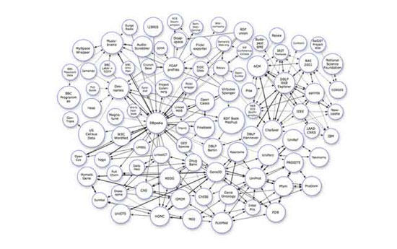
Welcome
to
Analysis and Design of Algorithms

Slide 2
Review
二维最近邻点问题，如果使用分治法，对于一个子集上的某一点，另一个子集上需要检查的点的个数是（ ）。
A 1个
B 2个
C 6个
D 8个
分治法是将一个大问题分解为若干子问题( )求解，而减治法是只求解( )。
C
分别
部分子问题

Slide 3
Review
假币问题
合并排序
折半查找
最大子段和
快排
二叉查找树
选择问题
最近点对
插入排序
堆排序
凸包
分治法
求解
减治法
求解

Slide 4
Transform and Conquer
That’s the secret to life ... replace one worry with another.
—— Charles M. Schulz
美国漫画家，Snoopy之父
This group of techniques solves a problem by a transformation to
a simpler/more convenient instance of the same problem (instance simplification)
a different representation of the same instance (representation change)
a different problem for which an algorithm is already available (problem reduction)
分两个阶段工作，即“变”阶段和“治”阶段

Slide 5
6.1 Instance simplification
Solve a problem’s instance by transforming it into another simpler/easier instance of the same problem
Presorting
Many problems involving lists are easier when list is sorted, e.g.
searching
computing the median (selection problem)
checking if all elements are distinct (element uniqueness)
Also:
Topological sorting helps solving some problems for dags.
Presorting is used in many geometric algorithms.

Slide 6
How fast can we sort ?
Presorting
Efficiency of algorithms involving sorting depends on
efficiency of sorting.
Recall Different Sorting
Theorem : ⎡log₂ n!⎤ ≈ n log₂ n comparisons are necessary in the worst case to sort a list of size n by any comparison-based algorithm.
Note: About nlog₂ n comparisons are also sufficient to sort array of size n (by mergesort).

Slide 7
Example 1:Element Uniqueness
Presorting
Brute force algorithm Compare all pairs of elements Efficiency: O(n²)
Presorting-based algorithm
Stage 1: sort by efficient sorting algorithm (e.g. mergesort)
Stage 2: scan array to check pairs of adjacent elements
Efficiency: Θ(nlog n) + O(n) = Θ(nlog n)
Another algorithm?
Hashing
Notes:
I see at least two objections to your linear-time solution for the element uniqueness problem. First, the algorithm you propose doesn't work, because hashing works for most datasets and most hashes, but by the pigeon hole principle, not always. If an adversary knows the hash you use, she can give you a list of items that all hash into the same bucket. (She simply draws n items from her favourite bucket. These exist, if the hash sufficiently reduces the length of the item, namely by at least log(n) bits).
Second, the assumption that hashing is in O(1) time, works in a computational model where you can manipulate these items in constant time, but this isn't necessarily realistic. Suppose that all of n elements are unique. Then each element is described by at least log(n) bits, so the length of these registers grows with n, so realistically you can't manipulate registers in constant time. Then hashing takes Ω(log(n)) time, and hashing n elements takes Ω(nlog(n)) time.
The same objection holds against the model where comparison is O(1); here sorting takes O(nlog(n)2) real-world steps, where n is the number of items, if you use QuickSort and use a black-box sorting algorithm. In a sense, this is a strange model; items can be compared in O(1) time, but they can't be hashed in O(1) time.

Slide 8
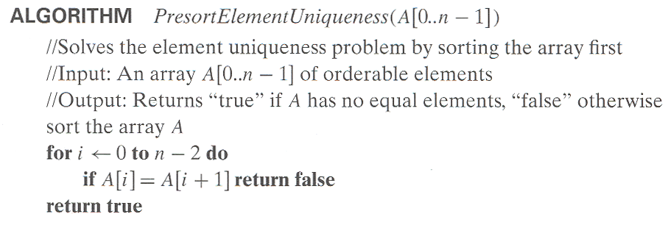
Presorting
To check the element uniqueness
T(n)=T_{sort}(n)+T_{scan}(n) ∈ Θ(nlogn)+ Θ(n)= Θ(nlogn)

Slide 9
Presorting
例2、模式计算
模式：指数组列表中出现次数最多的值。
如{5,1,5,7,6,5,7}中5是模式
一些求模式的方法：
用辅助列表列出所有元素及其出现频率。
时空效率如何分析？
采用排序的思想
先排序后计算相邻接次数最多的等值元素。
时空效率如何分析？

Slide 10
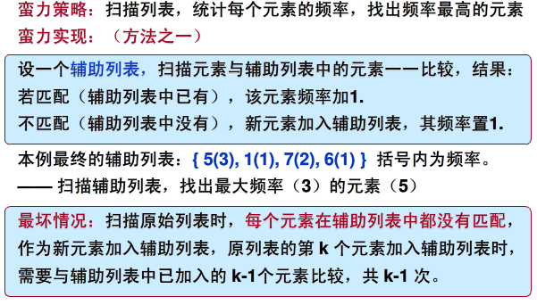
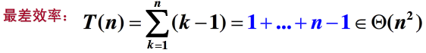
Presorting
例2、模式计算
模式：指数组列表中出现次数最多的值。
如{5,1,5,7,6,5,7}中5是模式

Slide 11
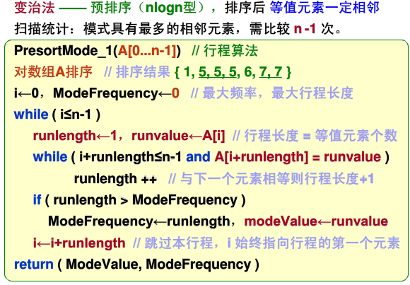
Presorting
例2、模式计算
模式：指数组列表中出现次数最多的值。
如{5,1,5,7,6,5,7}中5是模式

Slide 12
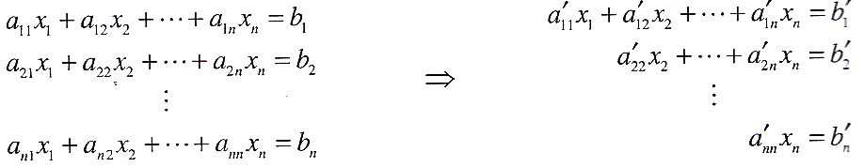
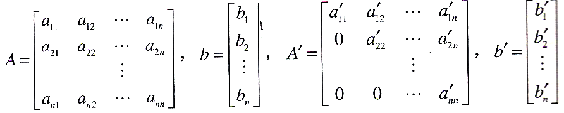
6.1 Instance simplification
Gaussian Elimination
Given: A system of n linear equations in n unknowns with an arbitrary coefficient matrix.
Transform to: An equivalent system of n linear equations in n unknowns with an upper triangular coefficient matrix.
Solve the latter by substitutions starting with the last equation and moving up to the first one.

Slide 13
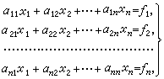
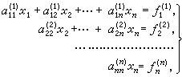
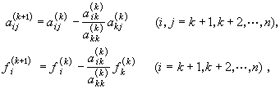
Gaussian Elimination (cont.)

Slide 14
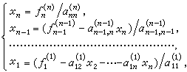
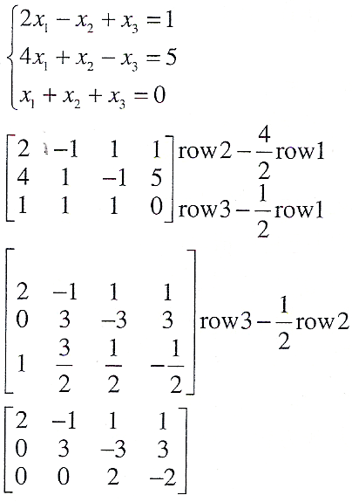
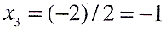
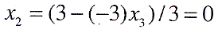
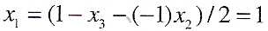
Gaussian Elimination (cont.)

Slide 15
Gaussian Elimination (cont.)
The transformation is accomplished by a sequence of elementary operations on the system’s coefficient matrix (which don’t change the system’s solution): for i ←1 to n-1 do replace each of the subsequent rows (i.e., rows i+1, …, n) by a difference between that row and an appropriate multiple of the i-th row to make the new coefficient in the i-th column of that row 0

Slide 16
Pseudocode and Efficiency of Gaussian Elimination
Stage 1: Reduction to an upper-triangular matrix
for i ← 1 to n-1 do
for j ← i+1 to n do for k ← i to n+1 do A[j, k] ← A[j, k] - A[i, k] * A[j, i] / A[i, i] //improve!
Stage 2: Back substitutions for j ← n downto 1 do
t ← 0
for k ← j +1 to n do
t ← t + A[j, k] * x[k] x[j] ← (A[j, n+1] - t) / A[j, j]

Slide 17
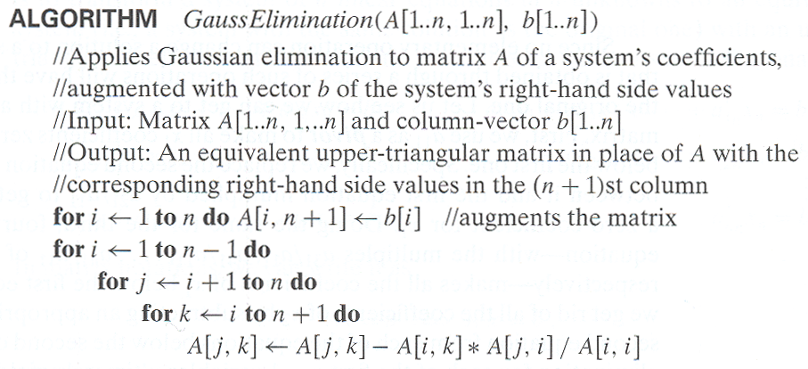
Gaussian Elimination (cont.)
缺点：A[i,i]=0；A[i,i]非常小，导致A[j,i]/A[i,i]非常大，
A[j,k]的新值会有舍入误差；内层循环效率非常低。

Slide 18
Gaussian Elimination (cont.)

Slide 19
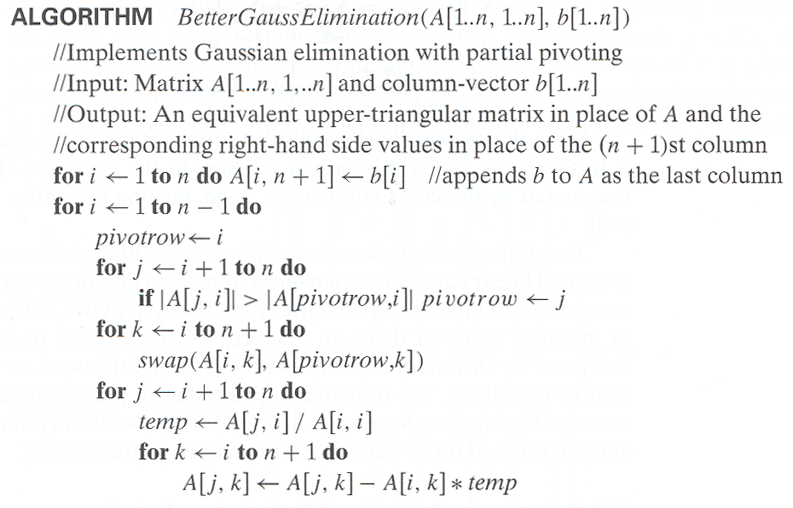
Gaussian Elimination (cont.)
部分主元法
每次寻找第i列系数
的绝对值最大的行，
把它作为第i次迭代
的基点。

Slide 20
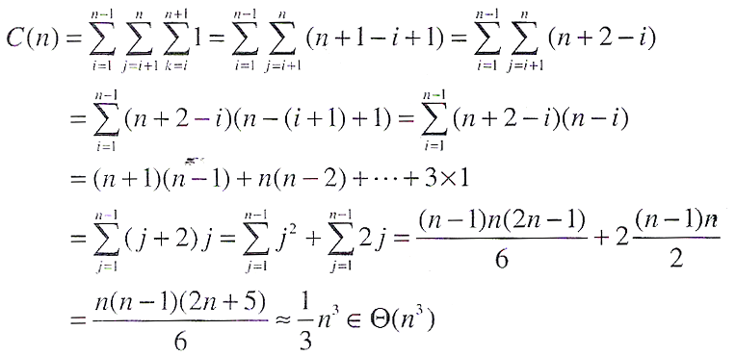
Gaussian Elimination (cont.)
Efficiency
反向替换的效率属于Θ(n²)
Efficiency: Θ(n³) + Θ(n²) = Θ(n³)

Slide 21
Gauss消去法-LU分解
高斯消去法的现代商业实现是以LU分解为基础的。
消去的结果
由主对角线上的1
以及在高斯消去过程中行的乘数构成
Notes:
https://www.geeksforgeeks.org/doolittle-algorithm-lu-decomposition/

Slide 22
Gauss消去法-LU分解
记原方程组为 A X =b，
A=LU
则原方程组为LUX=b
其求解转化为两个三角形方程组的求解：
LY=b —— 下三角方程组
UX=Y ——上三角方程组

Slide 23
Gauss消去法-LU分解
与LY=b, UX=Y对应的方程组如下：
易得：
(y₁,y₂,y₃)=(1,3,-2),
(x₁,x₂,x₃)=(1,0,-1)

Slide 24
LU分解
基于矩阵A的LU分解，无论对于什么样的右边向量b，都可以对方程组Ax=b求解。
LU分解可以不需要额外的存储空间 --》HOW
把U的非零部分存储到A的上三角部分，把L的非零部分存储到A的下三角部分
课外思考题：1. 调研学习并给出矩阵的LU分解方法。
2. 给出方案计算可逆矩阵的逆。

Slide 25
Searching Problem
思考：预排序还可以用在什么方面？
查找
Problem Recall: Given a (multi)set S of keys and a search key K, find an occurrence of K in S, if any
Searching must be considered in the context of:
file size (internal vs. external)
dynamics of data (static vs. dynamic)
Dictionary operations (dynamic data):
find (search)
insert
delete

Slide 26
Searching with presorting
Problem: Search for a given K in A[0..n-1]
Presorting-based algorithm:
Stage 1 Sort the array by an efficient sorting algorithm
Stage 2 Apply binary search
Efficiency: Θ(nlog n) + O(log n) = Θ(nlog n)
Good or bad?(<O(n) for linear search)
Why do we have our dictionaries, telephone directories, etc. sorted?
---if we have more searches than the cost will be worth.

Slide 27
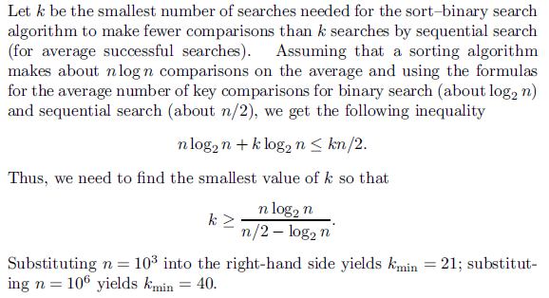
Searching with presorting
思考题：
采用合并排序为预排序，折半查找，要做多少次查找才能使得对一个由n个元素构成的数组所做的预排序是有意义的。

Slide 28
Taxonomy of Searching Algorithms
6.2 Representation Change
List searching
sequential search
binary search
interpolation search
Tree searching
binary search tree
binary balanced trees: AVL trees, red-black trees
multiway balanced trees: 2-3 trees, 2-3-4 trees, B trees
Hashing
open hashing (separate chaining)
closed hashing (open addressing)

Slide 29
Binary Search Tree
Arrange keys in a binary tree with the binary search tree property:
K
<K
>K

Slide 30
Dictionary Operations on Binary Search Trees
When not found? ancestor
Searching – straightforward
Insertion – search for key, insert at leaf where search terminated (where to insert)
Deletion – 3 cases:
deleting key at a leaf
deleting key at node with single child
deleting key at node with two children
Efficiency depends of the tree’s height: ⎣log₂ n⎦ ≤ h ≤ n-1, with height average (random files) be about 3log₂ n
Thus all three operations have
worst case efficiency: Θ(n)
average case efficiency: Θ(log n)
Bonus: inorder traversal produces sorted list
Maximum? Minimum?
Victim Node
# of comparation
=# of comparation of QuickSort whose pivot is the 1st
Notes:
1.41 lg n = 2 ln n

Slide 31
Balanced Search Trees
Attractiveness of binary search tree is marred by the bad (linear) worst-case efficiency.
Two ideas to overcome it are:
to rebalance binary search tree when a new insertion makes the tree “too unbalanced”
AVL trees(前苏联科学家 G.M. Adelson-Velsky 和 E.M. Landis )
red-black trees
to allow more than one key per node of a search tree
2-3 trees
2-3-4 trees
B-trees

Slide 32
Balanced trees: AVL trees
Definition An AVL tree is a binary search tree in which, for every node, the difference between the heights of its left and right subtrees, called the balance factor, is at most 1 (with the height of an empty tree defined as -1)
Tree (a) is an AVL tree; tree (b) is not an AVL tree
Two problems:
Minimum unbalanced tree
Balance Stragegies

Slide 33
Rotations
If a key insertion violates the balance requirement at some node, the subtree rooted at that node is transformed via one of the four rotations. (The rotation is always performed for a subtree rooted at an “unbalanced” node closest to the new leaf.)
Single R-rotation
Double LR-rotation

Slide 34
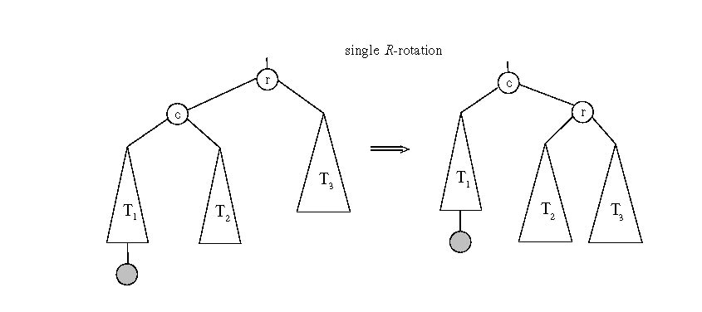
General case: Single R-rotation

Slide 35
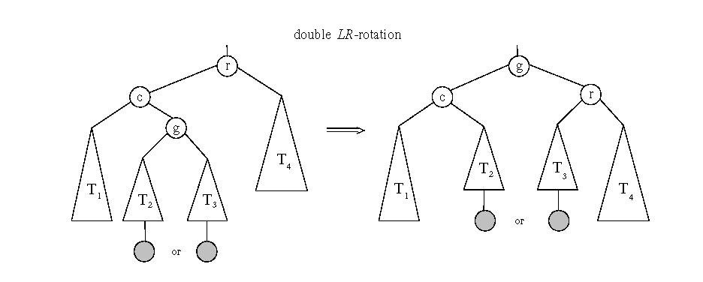
General case: Double LR-rotation

Slide 36
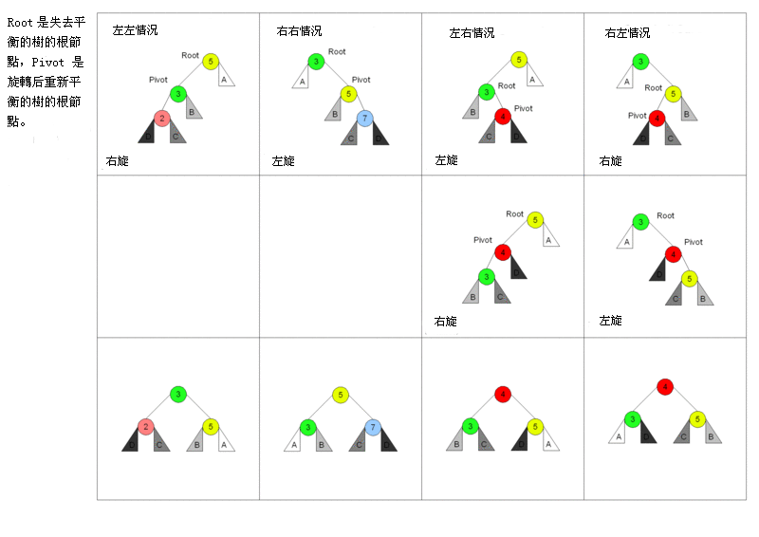
Four Rotations

Slide 37
AVL tree construction - an example
Construct an AVL tree for the list 5, 6, 8, 3, 2, 4, 7

Slide 38
AVL tree construction - an example (cont.)

Slide 39
Analysis of AVL trees
h ≤ 1.4404 log₂ (n + 2) - 1.3277
average height: 1.01 log₂n + 0.1 for large n (found empirically)
Search and insertion are O(log n)
Deletion is more complicated but is also O(log n)
Disadvantages:
frequent rotations
Complexity to balance
A similar idea: red-black trees (height of subtrees is allowed to differ by up to a factor of 2)
课外思考题：How to prove it?
课堂讨论题：How to compute it?
课堂讨论题：Delete & Rotate
Notes:
从平衡二叉树中删除节点更为复杂。首先第一步需要找到要删除的节点x，并分情况进行处理：如果要删除的节点为叶子节点，就找到了要删除的节点如果要删除的节点为只有一棵子树的节点就找到了要删除的节点如果要删除的节点既有左子树，又有右子树，则如果该节点的平衡因子为0或者1，则找到其左子树中具有最大值的节点max（我们只讨论有序平衡二叉树，并且有序平衡二叉树中任意一个节点的左子树上的所有节点的值小于该节点的值，右子树上所有节点的值大于该节点的值），将max的内容与x的内容交换（只替换保存的真正的数据，不替换指针，平衡因子等用于管理目的的信息），并且max即为新的要删除的节点。由于树是有序的，因而这样找到的节点要么是一个叶子节点，要么是一个没有右子树的节点。如果该节点的平衡因子为-1，则找到其右节点中具有最小值的节点min，将min的内容与x的内容交换，并且min即为新的要删除的节点。由于树是有序的，因而这样找到的节点要么是一个叶子节点，要么是一个没有左子树的节点。在找到要删除的节点后下一步就是删除节点，假设要删除的节点为delete，其父节点为parent，显然此时delete要么是一个叶子节点，要么是一个只有一棵子树的节点：如果delete是一个叶子节点，则直接删除它如果delete是一个只有一棵子树的节点，则将delete删除，delete节点的子树的根将成为parent的子节点无论是这两种情形中的哪一种都会导致节点parent的以delete节点为根节点的子树的高度降低，因此下一步就是处理高度降低的影响。假设删除节点导致以节点A为根的子树的高度降低了，并且A的父节点为B则：如果B为NULL，即A已经为根节点，则删除完成否则考察B的平衡因子：平衡因子为0，只需要调整平衡因子即可完成删除平衡因子表示以A为子树的根的高度较高，则B的新的平衡因子为0，以B为根的子树的高度降低，需要回溯往前继续处理高度降低的影响平衡因子表示以A为子树的根的高度较矮，则以B为根的子树违背了平衡二叉树的要求，需要对以B为根的子树进行调整，如果调整完后得到的新的子树的高度和原来以B为根的子树的高度相同，则删除完成，否则新得到的子树的高度与原来的以B为根的子树的高度相比必然是减小了，因而还需要继续往前回溯处理高度降低的影响
————————————————

Slide 40
Multiway Search Trees
Definition A multiway search tree is a search tree that allows more than one key in the same node of the tree.
Definition A node of a search tree is called an n-node if it contains n-1 ordered keys (which divide the entire key range into n intervals pointed to by the node’s n links to its children):
Note: Every node in a classical binary search tree is a 2-node
k₁ < k₂ < … < k_{n-1}
< k₁
[k₁, k₂ )
≥ k_{n-1}

Slide 41
2-3 Tree
Definition A 2-3 tree is a search tree that
may have 2-nodes and 3-nodes
height-balanced (all leaves are on the same level)
A 2-3 tree is constructed by successive insertions of keys given, with a 3-nodes, it’s split into two with the middle key promoted to the parent.

Slide 42
2-3 tree construction – an example
Construct a 2-3 tree the list 9, 5, 8, 3, 2, 4, 7

Slide 43
搜索算法
如果待搜索树的根是2-node型结点，搜索操作与二叉搜索树搜索操作相同；
如果待搜索树的根是3-node型结点，最多只需要比较两次就可以知道是搜索成功还是需要向3棵子树继续递归搜索。

Slide 44
插入算法：
当一个结点x需要插入到2-3树中的时候，总是根据它的大小关系，把其插入到叶结点中。
插入前首先调用搜索算法找到待插入的叶结点，如果该叶结点是2-node型的，则直接插入即可；
如果该叶结点是3-node型的，在按序插入到叶结点后，需要把叶结点拆分（因为插入后使得叶结点的关键字个数为3，不满足2-3树的要求）。
拆分过程首先在三个关键字挑选值在中间的关键字，提到上一层，或者作为新结点，或者插入原来的内结点中；关键字最小的作为左子树，关键字最大的作为右子树。如果内结点的插入导致结点过大，按照上述规则继续拆分。

Slide 45
2-3树的效率分析
操作效率与什么相关？
树高h
若有n个关键字，构成一棵全部由2节点构成的满树，n与h之间的关系为？
若有n个关键字，构成一棵全部由3节点构成的满树，n与h之间的关系为？
所以高度的范围是：
无论在最差还是平均，查找，插入和删除时间效率都是对数类型

Slide 46
Heaps and Heapsort
Definition A heap is a binary tree with keys at its nodes (one key per node) such that:
It is essentially complete, i.e., all its levels are full except possibly the last level, where only some rightmost keys may be missing
The key at each node is ≥() keys at its children

Slide 47
Illustration of the heap’s definition
a heap
not a heap
not a heap
Note: Heap’s elements are ordered top down (along any path down from its root), but they are not ordered left to right

Slide 48
Some Important Properties of a Heap
Given n, there exists a unique binary tree with n nodes that
is essentially complete, with h = ⎣log₂ n⎦
The root contains the largest key
The subtree rooted at any node of a heap is also a heap
A heap can be represented as an array

Slide 49
Heap’s Array Representation
Store heap’s elements in an array (whose elements indexed, for convenience, 1 to n) in top-down left-to-right order
Example:
Left child of node j is at 2j
Right child of node j is at 2j+1
Parent of node j is at ⎣j/2⎦
Parental nodes are represented in the first ⎣n/2⎦ locations
9
1 2 3 4 5 6
5
3
9 5 3 1 4 2
1
4
2

Slide 50
Heap Construction (bottom-up)
Step 0: Initialize the structure with keys in the order given
Step 1: Starting with the last (rightmost) parental node, fix the heap rooted at it, if it doesn’t satisfy the heap condition: keep exchanging it with its largest child until the heap condition holds
Step 2: Repeat Step 1 for the preceding parental node

Slide 51
Example of Heap Construction
Construct a heap for the list 2, 9, 7, 6, 5, 8

Slide 52
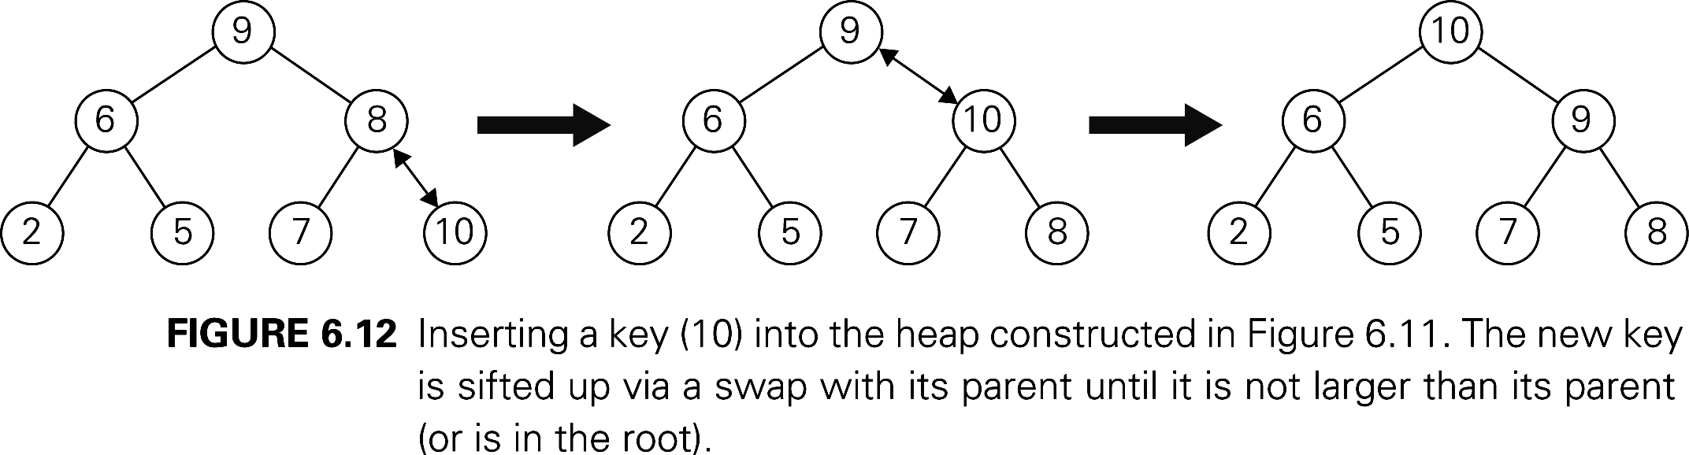
Heap Construction (top-down)

Slide 53
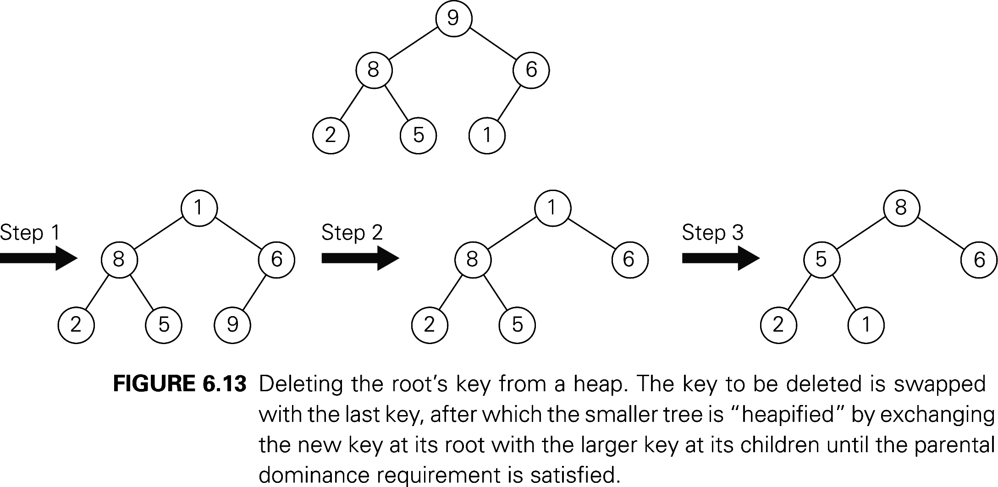
Delete the root

Slide 54
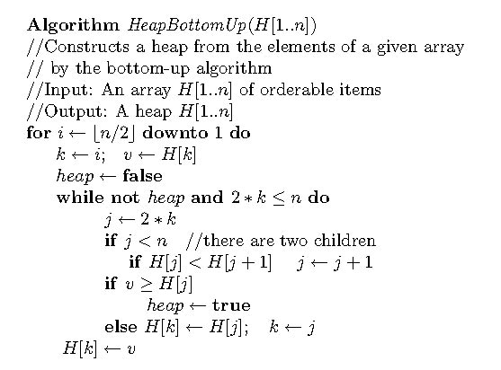
Pseudopodia of bottom-up heap construction

Slide 55
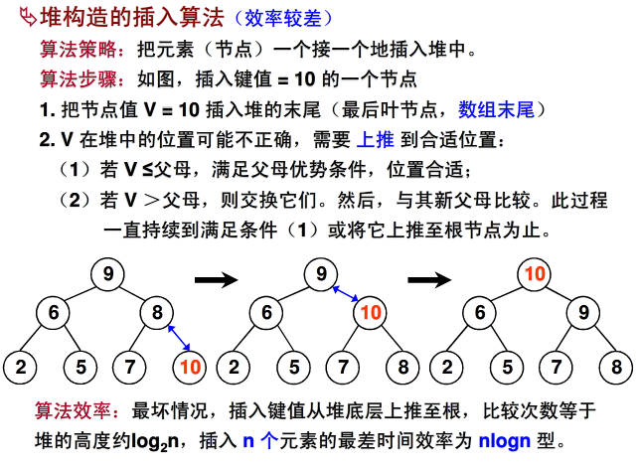
Heap

Slide 56
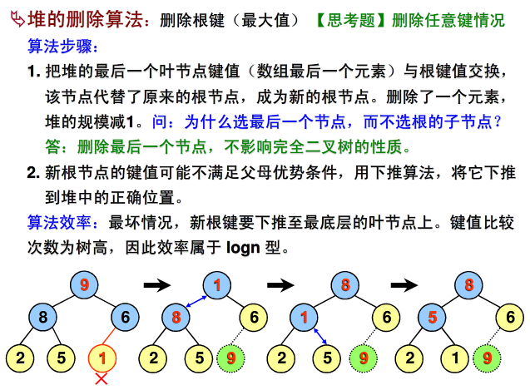
Heap

Slide 57
Heapsort
Stage 1: Construct a heap for a given list of n keys
Stage 2: Repeat operation of root removal n-1 times:
Exchange keys in the root and in the last (rightmost) leaf
Decrease heap size by 1
If necessary, swap new root with larger child until the heap condition holds

Slide 58
Example of Sorting by Heapsort
Sort the list 2, 9, 7, 6, 5, 8 by heapsort
Stage 1 (heap construction) Stage 2 (root/max removal)
1 9 7 6 5 8 9 6 8 2 5 7
2 9 8 6 5 7 7 6 8 2 5 | 9
2 9 8 6 5 7 8 6 7 2 5 | 9
9 2 8 6 5 7 5 6 7 2 | 8 9
9 6 8 2 5 7 7 6 5 2 | 8 9
2 6 5 | 7 8 9
6 2 5 | 7 8 9
5 2 | 6 7 8 9
5 2 | 6 7 8 9
2 | 5 6 7 8 9

Slide 59
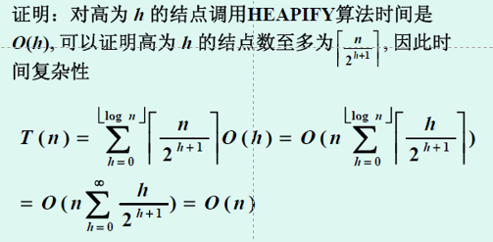
Analysis of Heapsort
Stage 1: Build heap for a given list of n keys
worst-case
C(n) =
Stage 2: Repeat operation of root removal n-1 times (fix heap)
worst-case
C(n) = Both worst-case and average-case efficiency: Θ(nlogn) In-place: yes Stability: no
h-1
Σ
2(h-i) 2^{i} = 2 ( n – log₂(n + 1)) ∈ Θ(n)
i=0
# nodes at level i
n-1
Σ
2log₂ i ∈ Θ(nlogn)
i=1

Slide 60
Analysis of Heapsort
Stage 1: Build heap for a given list of n keys
worst-case
C(n) =
Stage 2: Repeat operation of root removal n-1 times (fix heap)
worst-case
C(n) =
Both worst-case and average-case efficiency: Θ(nlogn) In-place: yes Stability: no
课外思考题：证明stage 1的时间性能为 Θ(n)
n-1
Σ
2log₂ i ∈ Θ(nlogn)
i=1

Slide 61
Priority Queue
A priority queue is the ADT of a set of elements with
numerical priorities with the following operations:
find element with highest priority
delete element with highest priority
insert element with assigned priority (see below)
Heap is a very efficient way for implementing priority queues
Two ways to handle priority queue in which highest priority = smallest number

Slide 62
Insertion of a New Element into a Heap
Insert the new element at last position in heap.
Compare it with its parent and, if it violates heap condition, exchange them
Continue comparing the new element with nodes up the tree until the heap condition is satisfied
Example: Insert key 10
Efficiency: O(log n)

Slide 63
Delete the root

Slide 64
Horner’s Rule For Polynomial Evaluation
Given a polynomial of degree n
p(x) = a_{n}x^{n} + a_{n-1}x^{n-1} + … + a₁x + a₀
and a specific value of x, find the value of p at that point.
Two brute-force algorithms:
p ← 0 p ← a₀; power ← 1
for i ← n downto 0 do for i ← 1 to n do
power ← 1 power ← power * x
for j ← 1 to i do p ← p + a_{i} * power
power ← power * x return p
p ← p + a_{i} * power
return p

Slide 65
Horner’s Rule
Example: p(x) = 2x⁴ - x³ + 3x² + x - 5
= x(2x³ - x² + 3x + 1) - 5
= x(x(2x² - x + 3) + 1) - 5
= x(x(x(2x - 1) + 3) + 1) - 5
Substitution into the last formula leads to a faster algorithm
Same sequence of computations are obtained by simply arranging the coefficient in a table and proceeding as follows:
coefficients 2 -1 3 1 -5
x=3

Slide 66
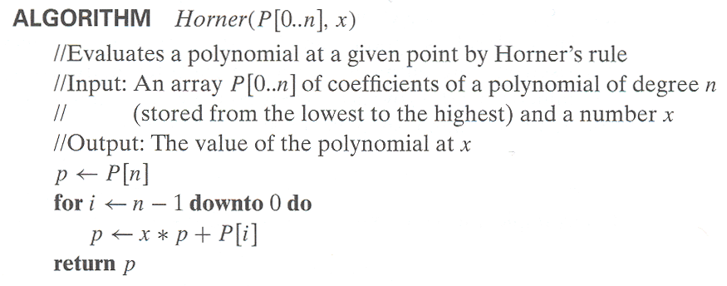
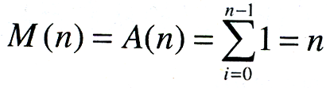
Horner’s Rule pseudocode
Efficiency of Horner’s Rule: # multiplications = # additions = n

Slide 67
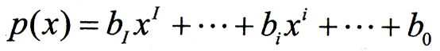
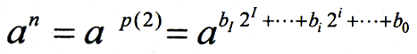
Computing a^{n} (revisited)
Left-to-right binary exponentiation Initialize product accumulator by 1.
Scan n’s binary expansion(n=b_{I}…b_{i}…b₀) from left to right and do the following:
If the current binary digit is 0, square the accumulator (S); if the binary digit is 1, square the accumulator and multiply it by a (SM).
Example: Compute a¹³. Here, n = 13 = 1101₂ binary rep. of 13: 1 1 0 1 SM SM S SM accumulator: 1 1²*a=a a²*a = a³ (a³)² = a⁶ (a⁶)²*a= a¹³ (computed left-to-right) Efficiency: b ≤ M(n) ≤ 2b where b = ⎣log₂ n⎦ + 1

Slide 68
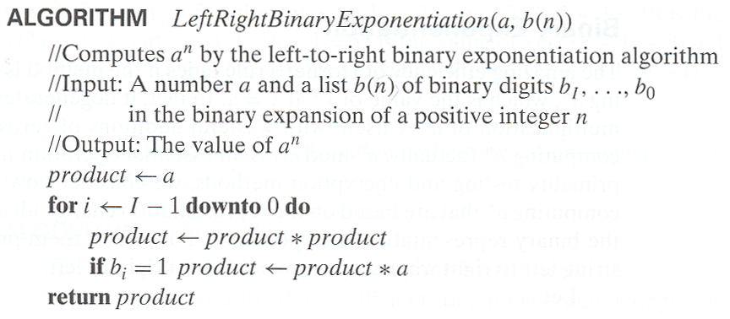
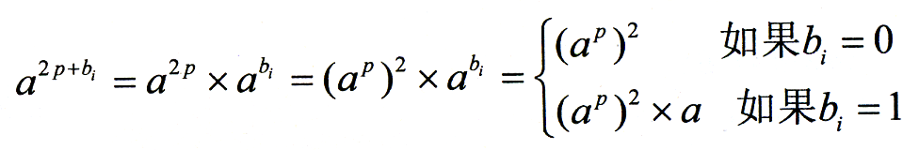
Binary Exponentiation

Slide 69
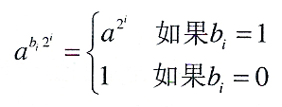
Computing a^{n} (cont.)
Right-to-left binary exponentiation
Scan n’s binary expansion from right to left and compute a^{n} as the product of terms a^{2 i} corresponding to 1’s in this expansion.
Example Compute a¹³ by the right-to-left binary exponentiation. Here, n = 13 = 1101₂.
1 1 0 1 a⁸ a⁴ a² a : a^{2 i} terms a⁸ * a⁴ * a : product (computed right-to-left)
Efficiency: same as that of left-to-right binary exponentiation

Slide 70
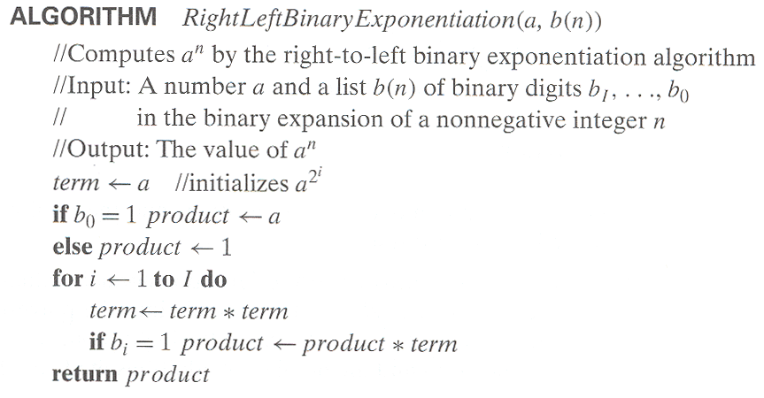
Binary Exponentiation

Slide 71
例子
快速求正整数次幂，当然不能直接死乘。举个例子：
3 ^ 999 = 3 * 3 * 3 * … * 3
直接乘要做998次乘法。
3 ^ 2 = 3 * 3 3 ^ 4 = (3 ^ 2) * (3 ^ 2) 3 ^ 8 = (3 ^ 4) * (3 ^ 4) 3 ^ 16 = (3 ^ 8) * (3 ^ 8) 3 ^ 32 = (3 ^ 16) * (3 ^ 16) 3 ^ 64 = (3 ^ 32) * (3 ^ 32) 3 ^ 128 = (3 ^ 64) * (3 ^ 64) 3 ^ 256 = (3 ^ 128) * (3 ^ 128) 3 ^ 512 = (3 ^ 256) * (3 ^ 256)

Slide 72
例子
再相乘：
3 ^ 999 = 3 ^ (512 + 256 + 128 + 64 + 32 + 4 + 2 + 1) = (3 ^ 512) * (3 ^ 256) * (3 ^ 128) * (3 ^ 64) * (3 ^ 32) * (3 ^ 4) * (3 ^ 2) * 3
这样只要做16次乘法。即使加上一些辅助的存储和运算，也比直接乘高效得多（尤其如果这里底数是成百上千位的大数字的话）
把999转为2进制数：1111100111，其各位就是要乘的数

Slide 73
Problem Reduction
This variation of transform-and-conquer solves a problem by a transforming it into different problem for which an algorithm is already available.
To be of practical value, the combined time of the transformation and solving the other problem should be smaller than solving the problem as given by another method.

Slide 74
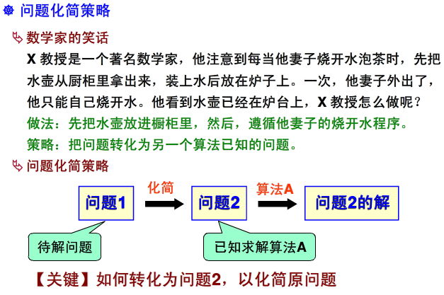
Problem Reduction

Slide 75
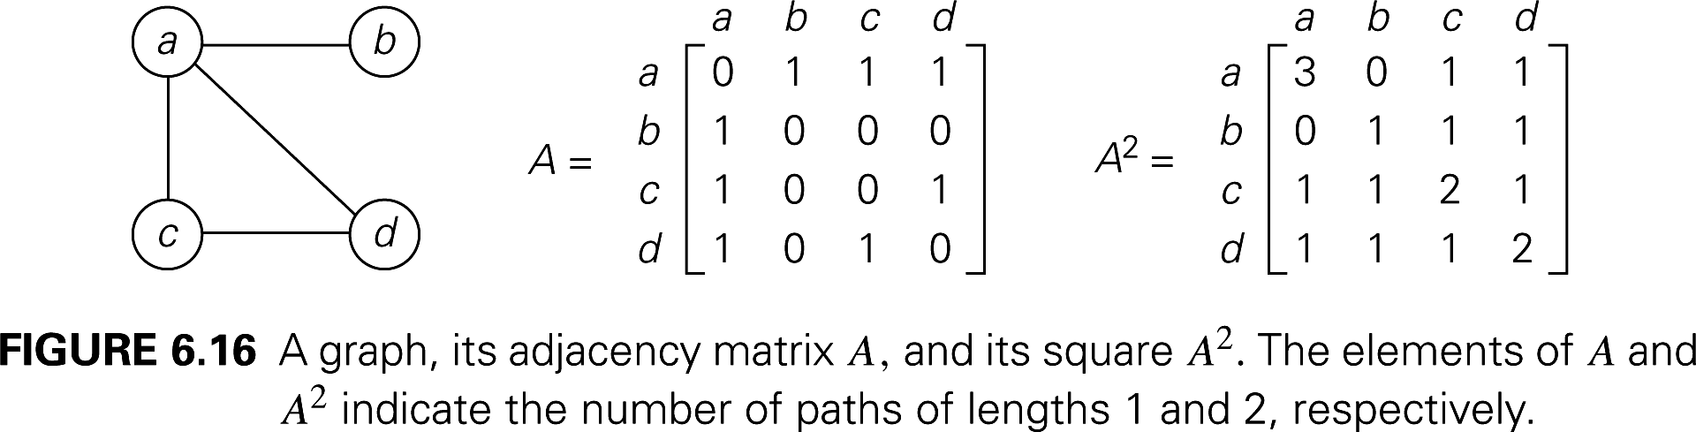
Examples of Solving Problems by Reduction
computing lcm(m, n) via computing gcd(m, n)
lcm(m,n)=(m×n)/gcd(m,n)
counting number of paths of length n in a graph by raising the graph’s adjacency matrix to the n-th power

Slide 76
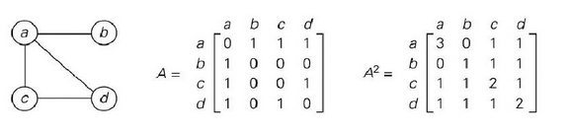
计算图中的路径数
原问题：
计算图中两个顶点之间的路径数量
问题化简：
可利用邻接矩阵，可以证明：
图G中顶点v_{i}到顶点v_{j}之间长度为k的路径数量等于A^{K}的第(i,j)个元素，其中A是图G的邻接矩阵。
课外思考题：证明

Slide 77
优化问题的化简
原问题：
求函数的最大值或最小值
问题化简：
已知函数的最大值的算法
求其最小值
min f(x)=-max[-f(x)]
函数最优化：
把最优化问题转化为函数极值问题，再由 f’(x)=0求临界点。

Slide 78
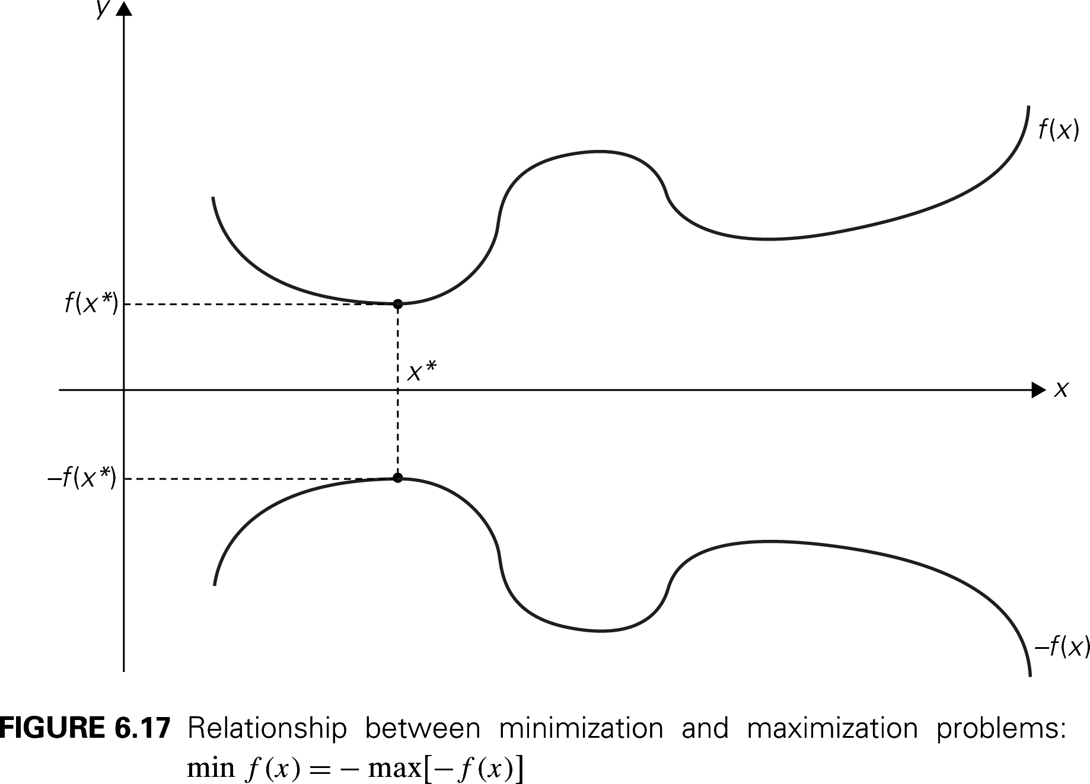
Examples of Solving Problems by Reduction
transforming a maximization problem to a minimization problem and vice versa (also, min-heap construction)

Slide 79
Liner Programming
线性规划问题是一个多变量线性函数的最优化问题，这些变量所要满足的一些约束是以线性等式或不等式形式出现的。
例1：假定一个大学基金需要进行一亿美元的投资。必须分成三种类型的投资：股票、债券和现金，预期的年收益分别为10%,7%和3%。因为股票风险更高，要求投资在股票上的资金不能超过证券投资的1/3，此外，现金投资至少应相当于股票和债券投资总额的25%。请问如何投资才能使收益最大化？

Slide 80
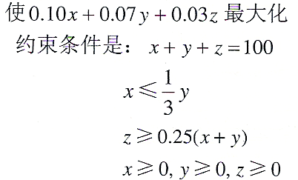
线性规划(Liner Programming)
建立数学模型，设x,y,z分别是投资在股票、债券和现金上的金额(以100万美元为单位)，有：
极大化的线性函数
问题约束
非负变量

Slide 81
线性规划
解线性规划问题的算法：
单纯形法 （最差时间复杂度为指数）
Karmarkar算法（最差时间复杂度为多项式）
课外思考题：调研线性规划问题求解算法

Slide 82
线性规划
整数线性规划：
把变量的值限定在整数。
算法：
目前还没有一个已知的多项式级的求解算法。

Slide 83
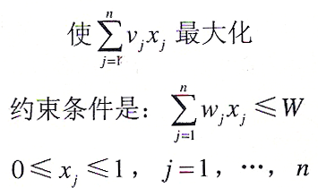
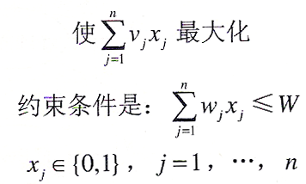
线性规划(Liner Programming)
背包问题的线性规划
连续(小数)版本 离散(0-1)版本

Slide 84
简化为图问题
许多问题用图表示后，求解很容易。通常用图的顶点表示问题的状态，边表示状态之间的可能转变。表示问题的图称为状态空间图。
状态空间图
图中的一个顶点代表初始状态，另一个顶点代表问题的目标状态（目标状态的顶点可能会有若干个）。
这种变换把问题化简为一个求初始状态顶点到目标状态顶点间的路径问题。

Slide 85
简化为图论问题
例如过河问题：
一个农夫希望用一条小船把一只狼，一头羊，一篮白菜从河的北岸渡到河的南岸，由于船小只能够容纳人狼羊菜中的两个。需要考虑的约束条件是：在没有人的情况下，狼和羊不能在一起，羊和白菜不能单独在一起。求解一个渡船的方案，把狼、羊、白菜都运过去。

Slide 86
简化为图论问题
对过河问题，画出人、狼、羊、菜的状态空间图后即可以发现有从初始化状态到目标状态的路径，就是问题的解。
用四维0-1向量表示(人,狼,羊,菜)在河西岸的状态(在河西岸则分量取1,否则取0),共有2⁴ =16 种状态.在河东岸的状态类似记作.
由题设,状态(0,1,1,0),(0,0,1,1),(0,1,1,1)是不允许的,从而对应状态(1,0,0,1), (1,1,0,0), (1,0,0,0)也是不允许的.
以可允许的10个状态向量作为顶点,将可能互相转移的状态用线段连接起来构成一个图.
根据此图便可找到渡河方法.

Slide 87
简化为图论问题
(1,1,1,1) (1,1,1,0) (1,1,0,1) (1,0,1,1) (1,0,1,0)
(0,0,0,0) (0,0,0,1) (0,0,1,0) (0,1,0,0) (0,1,0,1)
(0,1,0,1) (0,1,0,0) (0,0,1,0) (0,0,0,1) (0,0,0,0)
(1,0,1,0) (1,0,1,1) (1,1,0,1) (1,1,1,0) (1,1,1,1)
将10个顶点分别记为A₁, A₂, …, A₁₀ ,则渡河问题化为在该图中求一条从A₁到A₁₀的路. 从图中易得到两条路：
A₁ A₆ A₃ A₇ A₂ A₈ A₅ A₁₀;
A₁ A₆ A₃ A₉ A₄ A₈ A₅ A₁₀.

Slide 88
End of This Chapter

